Slide 1

IBM DATA SCIENCE PROFESSIONAL CERTIFICATION
CAPSTONE PROJECT ON
COMMUNITY MAPPING WITH GEOGRAPHICAL COORDINATES USING FOURSQUARE RESOURCES
BY
IDOKO JOB JOHN
April 2020

Slide 2
OUTLINE
Introduction/Business Problem
Method of Study
Importing Required Python Libraries
Data Acquisition and Processing
Data Presentation
Generating a Community Map of Staten Island
Result Presentation, Analysis and Discussion

Slide 3
Introduction/Business Problem
Community mapping is the creation of pictures of the geographical entities.
Maps are Needed for:
Navigation
City Planning
Surveying
Roads, Railways, Airports planning

Slide 4
Method of Study
Importing Required Python Libraries
Data Acquisition and Processing
Generating a Community Map of Staten Island
Defining an instance of the geocoder
Creating the Community Map

Slide 5
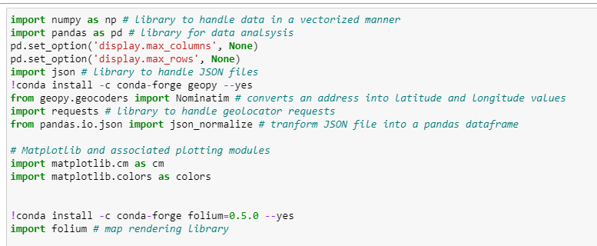
REQUIRED PYTHON LIBRARIES
Figure 1: Python Syntaxes for Importing the Relevant Libraries

Slide 6
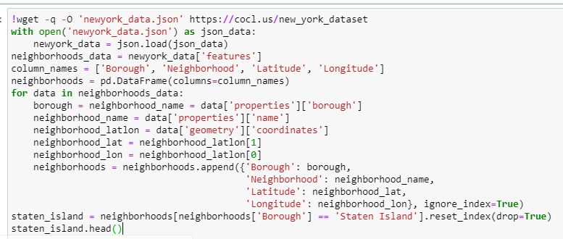
Data Acquisition and Processing
Figure 2: Python Syntax for obtaining and processing the needed data

Slide 7
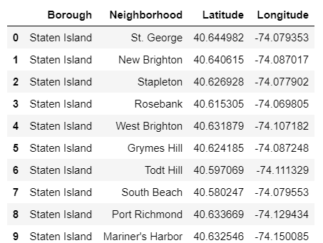
DATA PRESENTATION
Figure 3: Snapshot of Pandas data frame showing the first 10 rows of the data (Neighbourhoods of Staten Island
with their Latitude and Longitude)

Slide 8
Generating a Community Map of Staten Island
In Three Steps:
Defining an instance of the geocoder with a user agent
Generate the longitude and latitude of the Staten Island Borough
Create map with python folium library

Slide 9
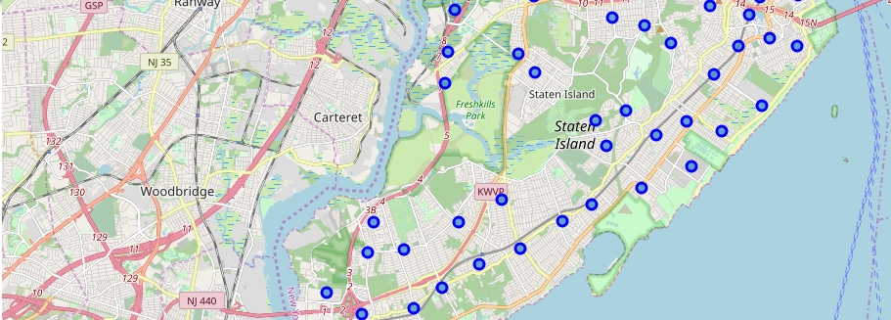
RESULTs PRESENTATION
Neighbourhoods
Figure 4: Map of Staten Island Showing Neighbourhoods

